Slide 1
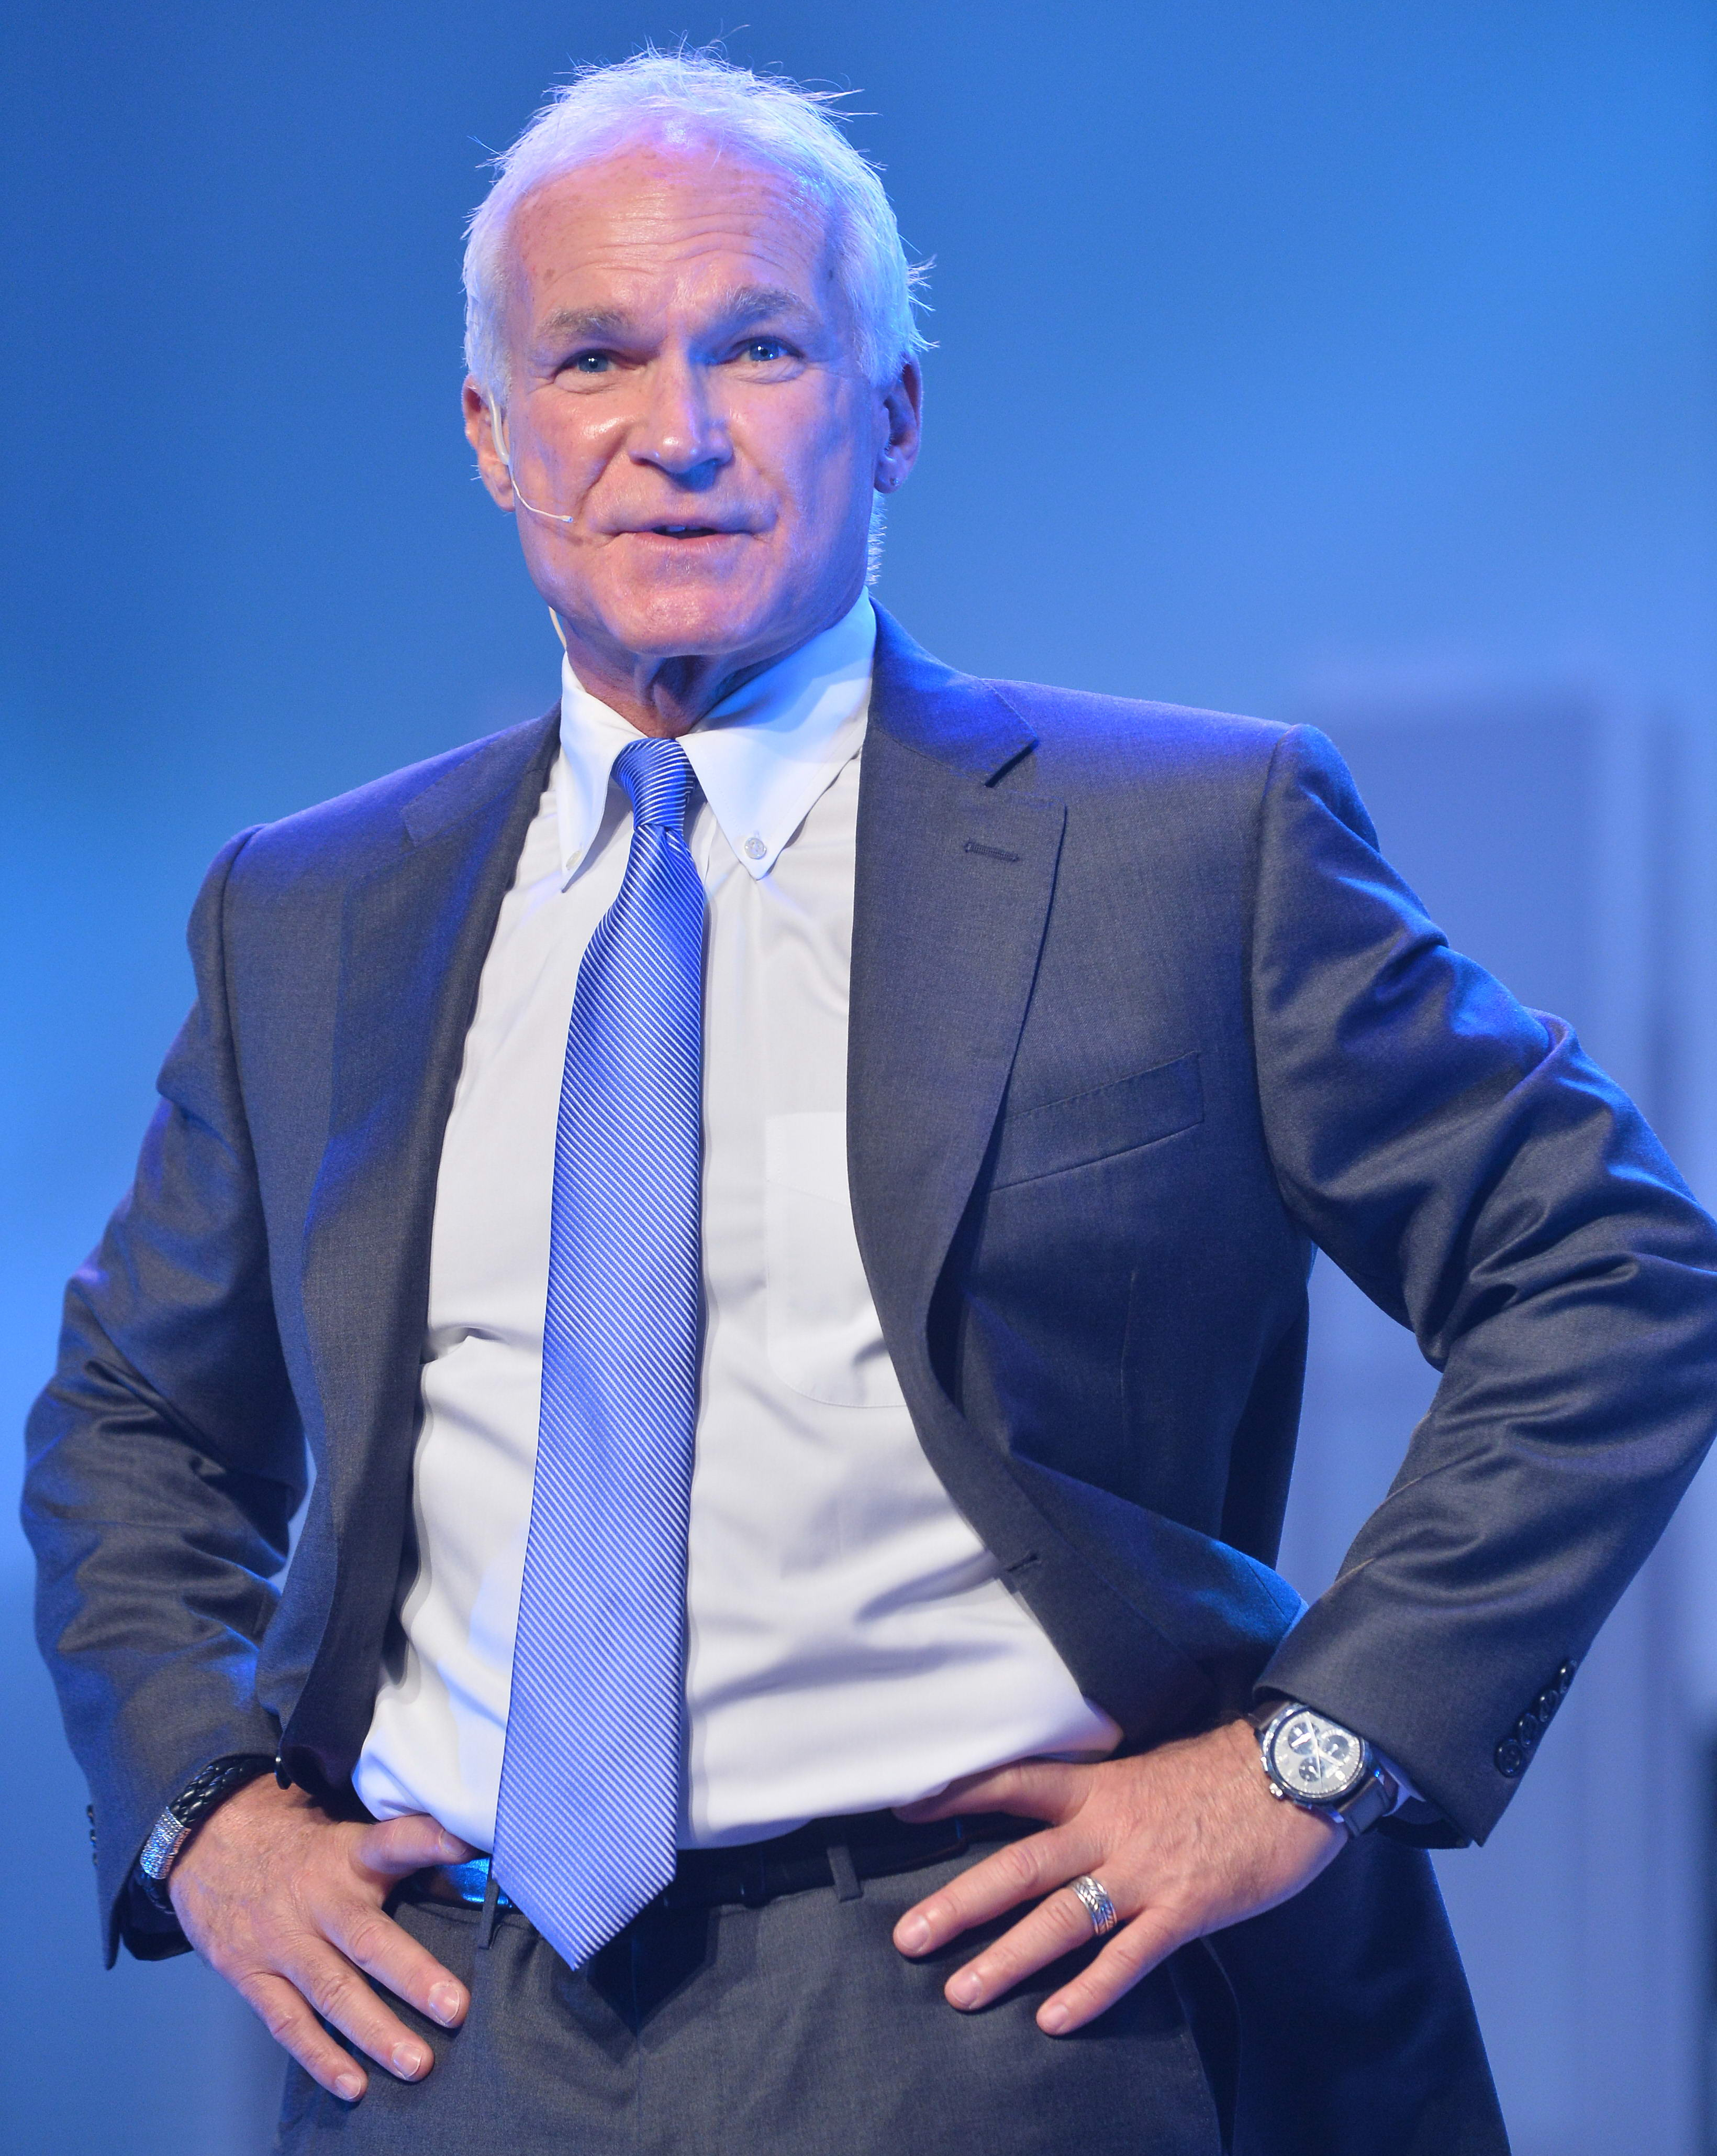
購物年金 — 招募新策略
Recruiting with Shopping Annuity
Kevin Buckman
特別企劃顧問
Special Projects Consultant

Slide 2
NMTSS
會議聯盟系統
超連鎖™系統的關鍵
A KEY COMPONENT
OF THE
UNFRANCHISE™ SYSTEM

Slide 3
美安香港四基石 FOUR CORNERSTONES OF MARKET HONG KONG FOUNDATION
雙軌行銷計劃與管理業績紅利計劃
商品代理系統與無牆百貨商場®
一對一行銷
超連鎖™事業發展系統
Binomial Marketing and Management Performance Compensation Plan
Product Brokerage System and Mall Without Walls®
One–to–One Marketing
UnFranchise™ Business Development System

Slide 4
雙軌行銷計劃與管理業績紅利計劃 BINOMIAL MARKETING AND MANAGEMENT PERFORMANCE COMPENSATION PLAN
以深度，而非廣度建立事業
更易獲利及穩定
強調「團隊vs.個人」，並藉以借力
把組織內的競爭降至最低
Build in depth not width
Profitability and Stability
Emphasize Team vs. Individual to create leverage
Minimizes competition within an organization

Slide 5
水平式行銷
HORIZONtal Marketing Structure
鼓勵團隊合作
ENCOURAGES TEAMWORK
全部一起合作
ALL WORKING TOGETHER
每個人都可以100%獲得銷售收入及所產生的點數
EVERYONE RECEIVES 100% CREDIT FOR SALES AND VOLUME GENERATED
地產、保險、行銷、傳統產業
REAL ESTATE, INSURANCE, SALES, TRADITIONAL BUSINESS
收入的多寡不取決於職位
EARNING POTENTIAL IS NOT DETERMINED BY POSITION
全部彼此競爭
ALL IN COMPETITION

Slide 6
產品代理系統與無牆百貨商場® PRODUCT BROKERAGE SYSTEM AND MALL WITHOUT WALLS®
不進行生產
- 免除生產成本
- 免除庫存成本
- 免受市場潮流波動成本拖累
- 避免出現單一產品類別/系列
Do not manufacture
Eliminate costs of making
Eliminate costs of inventory
Eliminate cost of marketplace swings
Eliminate one category/line of product
Dynamic vs. Static Model
Identify trends in market and products in current demand
Secure manufacture of better "product"
Let products go that have lost demand
Provide multiple product categories and lines
動態vs.靜態模式
- 分別出當下的市場潮流與熱門產品
- 確保取得較佳「產品」
- 淘汰低需求產品
- 提供多元化產品類別與系列

Slide 7
一對一行銷 ONE–TO–ONE MARKETING
Most efficient & effective method of selling & distributing
Easier to sell more product to fewer people
Easier to sell to satisfied customers
Easier to collect info from dialogue with customers
最高效的行銷方式
-更容易將更多產品銷售給更少人
-更容易銷售給滿意的顧客
-更容易透過與顧客的對話搜集資訊
HK. SHOP. COM網站切合顧客需要
-容許只購買少量的美安香港品牌產品
-夥伴商店不受內容或時間限制
-網上曝光率
HK.SHOP.COM Website ensures relevancy
Allows for carrying minimal inventory of Market Hong Kong branded product
Partner Stores allows for Whatever...Whenever
Online presence and exposure

Slide 8
超連鎖™事業發展系統 UNFRANCISE™ BUSINESS DEVELOPMENT SYSTEM
有助於複製 — 「借力」
-系統
-標準
-一致
Facilitates Duplication- "LEVERAGE"
Systematic
Standardized
Uniform
NMTSS為關鍵要素
- 開放式會議丶訓練及研討會系統
- 將地理涵蓋範圍增至最大
- 不受距離限制擴展事業版圖
- 各地皆能與優秀的訓練員聯絡
NMTSS is The Key Component
Open meetings, training and seminar system
Allows for maximum geographic exposure
Levels the playing field for building at distance
Allows for universal access to the very best trainers

Slide 9
NMTSS核心宗旨 NMTSS CORE OBJECTIVES
核心宗旨是
- 銷售與使用產品
- 共建購物年金
- 共享事業
- 賣票(教育培訓)
WHAT
Selling and Using Products
Sharing the Shopping Annuity
Sharing the Business
Selling Tickets (Education)

Slide 10
NMTSS核心宗旨 NMTSS CORE OBJECTIVES
如何
- 態度與知識
- 目標設定
- 零售
- 物色及推薦
- 跟進及ABC法則，
打造深度
HOW
Attitude and Knowledge
Goal Setting
Retailing
Prospecting & Sponsoring
Follow Up & ABC Pattern of Building Depth

Slide 11
NMTSS核心宗旨 NMTSS CORE OBJECTIVES
為甚麼
- 開發人力，賦予活力
- 借力成長
- 累積倍數成果(BV/IBV = $$$)
WHY
Developing & Empowering People
Leveraged Growth
Exponential Results (BV/IBV = $$$)

Slide 12
會議聯盟系統
National Meeting, Training and Seminar System
(NMTSS)
證實可行的會議丶研討會及大會系統，提供標準的有效訓練，為新加入或資深超連鎖™店主提供個人學習機會。
A proven system of meetings, seminars and events that provide new and established UnFranchise™ Owners with individual learning opportunities that contribute to standardized and effective training.

Slide 13
家庭事業 簡報會
Home Business Presentation
小組面談/ 餐會
Group Interviews/ Business Lunches
二對一面談
2-on-1
線上研討會
Webinar
實施方法
Approaches
人選名單
Names List

Slide 14
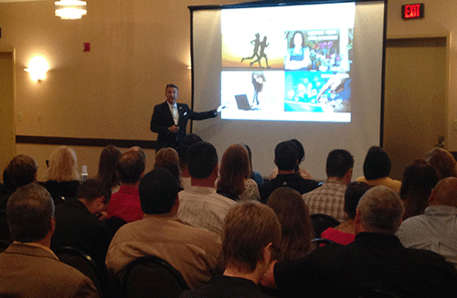
二對一面談
2-on-1
家庭事業簡報會
HBP
小組面談/餐會
Group Interviews/ Business Lunches
會後會
MEETING AFTER MEETING
線上研討會
Webinar
決定起步 或者回答問題
Decision to get started OR answer questions
約見成功
超連鎖™店主
超連鎖™事業
簡報會
UnFranchise™ Business Presentation
Meet Successful UnFranchise™ Owners
預約下次會面
FOLLOW Up Appt.

Slide 15
一般事業訓練，包括新超連鎖™店主訓練、成功五要訣訓練及
授證經理級訓練
General Business Trainings NUOT, Basic 5, ECCT
超連鎖™事業簡報會 (UBP)
美安大學主修課訓練，包括TLS、Motives、網路中心等
University Specific Trainings
TLS, Motives, WebCenter, nutraMetrix, etc
本地研討會
Local Seminars
香港年會
Regional Convention
國際年會
International Convention
世界大會
World Conference

Slide 16
會後會
MEETING AFTER MEETING
請團隊中資深夥伴幫助你安排預約下次會面及銷售下一次的大會門票
Let your experienced teammates help you to schedule a follow up appointment and sell tickets to the next event

Slide 17
推展下一場本地及/或所屬地區的大會並賣票
Promote your next Local and/or Regional Events and sell tickets

Slide 18
會後會
MEETING
AFTER MEETING

Slide 19
在展示美安事業計劃之後（跟進）
After showing the plan (follow up)
在超連鎖™事業簡報會之後
After the UBP
當新超連鎖™店主加入時
During new business owner registration
產生迫切感
Create a sense of urgency
賣票
(教育培訓)
在電話工作坊中
During call workshops
與踏實穩定型和等待觀望型夥伴通電話
Call stable and waiting

Slide 20
推展下一場本地及/或所屬地區的大會並賣票
PROMOTE YOUR NEXT LOCAL AND/OR REGIONAL EVENTS AND SELL TICKETS

Slide 21
透過從大會到大會建立事業 Building from Event to Event
意思是甚麼？你真的有做到嗎？
What does that mean and are you really doing it?

Slide 22
透過從大會到大會建立事業 Building from Event to Event
我如何說服大家參加大會?
你知道自己為何難以說服他人參加大會嗎?
How do I get people to the meetings?
Do you know why you are having problems getting people to meetings?

Slide 23
透過從大會到大會建立事業 Building from Event to Event
動能產生動能。你的所作所為皆能複製!
你要複製的是優點，不是缺點!
你要複製正確的做法，而非錯誤的做法!
What you set in motion carries in motion. Everything you do duplicates!
You want to make sure that you duplicate strength not weakness!
You want to duplicate the right things not the wrong things!

Slide 24
透過從大會到大會建立事業 Building from Event to Event
你有參加下一場大會的門票嗎?
你的團隊有參加下一場大會的門票嗎? 你如何丶何時宣傳下一場大會?
你有營造迫切感嗎?
Do you have tickets to the next event? Does your organization have tickets to the next event?
How and when are you promoting the next event?
Are you creating a sense of urgency?

Slide 25
透過從大會到大會建立事業 Building from Event to Event
事業發展不順的原因
-你沒預先購買門票!
-你沒使用「起步指南」正確引導他人開始事業!
-你沒管理出席大會人數!
-你沒有正確宣傳大會!一切始於「行動計劃」!我每次在說明計劃時,一定把重點放在銷售下一場大會門票上!並營造興奮集氣氛!
Reasons you are struggling building from event to event
You don’t buy tickets in advance!
You don’t get people started correctly using the Getting Started Guide!
You don’t monitor the number of people you have at the events!
You don’t promote the events properly! It starts in The Plan! I’m always focused on selling the next event every time I show the plan! Create excitement!

Slide 26
透過從大會到大會建立事業 Building from Event to Event
你沒有門票，就無法銷售﹗
You CAN’T sell a ticket that you don’t have!

Slide 27
透過從大會到大會建立事業 Building from Event to Event
我們的辦公室在何處?
我們的辦公室就在NMTSS!
你願意花多少錢取得?
我們的租金還包括持續教育的學費
Where is our office?
Our office is the NMTSS!
How much are you willing pay for it?
Our rent also includes continuing education fees

Slide 28
透過從大會到大會建立事業 Building from Event to Event
我們跟任何事業都一樣必須付錢接受訓練︰
-特許經營
-地產
-律師
-醫生
-髮型師
We have to pay for trainings just like any business:
Franchise
Real Estate
Lawyer
Doctor
Hair Dresser

Slide 29
透過從大會到大會建立事業 Building from Event to Event
我們NMTSS租金多少?
你想向誰學習?
我想向業界佼佼者學習!
What does our rent for the NMTSS cost?
Who do you want to learn from?
I want to be taught by the best in the business!

Slide 30
透過從大會到大會建立事業 Building from Event to Event
我們以創業家的身分聚首，幫人節省開支
我們跟傳統產業比較
- 在場誰擁有傳統產業?
- 當初花費了多少起頭?
- 你每月開支多少?
We come together as entrepreneurs to make it less expensive for everyone
Let’s compare to a traditional business
Who in here owns a traditional business?
What did it cost to start?
What is your monthly overhead?

Slide 31
傳統產業
Traditional Business
賺取$100,000/每年
To Make $ 100,000/Year
投資5 x淨= $500,000
操作： $50k – $100k 下
抵押一切
爸媽︰賺錢維生 $30k–$100k
$100k 投資成本
Investment 5 x Net = $500,000
Leverage: $50k – $100k Down
Mortgage Everything
Mom & Pop: Make a Living $30k – $100k
$100k in Start-Up Cost

Slide 32
傳統產業 TRADITIONAL BUSINESS
Time - 60hrs - Expensive Job
Expansion = More Investment
$
Pilferage, Theft, Slippage
Security
自由
Freedom
Local, State, Federal Regulations
Accountants
Paperwork
Secretaries
Computers
Upgrades
Network
Obsolete
Supplies
Advertising
FICA
Unemployment
Inventory
Vehicles
Taxes
Furniture
Forms
Employees
Insurance
License
Building, Store
Office Lease,
Utilities
Investment 100k - 500k,
Equipment

Slide 33
透過從大會到大會建立事業 Building from Event to Event
超連鎖™每月開支UnFranchise™ Monthly Overhead
超連鎖™管理系統UFMS - HK$150 HK$150
超連鎖™事業簡報會UBP - HK$30 (2/月 & 2/嘉賓) = HK$120 HK$120
本地研討會LS(5) - HK$150 (3/本地 - HK$450) = HK$2250 HK$188-HK$63
年會Annual Convention - HK$895(3) = HK$2685 HK$224-HK$75
領袖訓練會議Leadership School - HK$895(3) = HK$2685 HK$224-HK$75
新超連鎖™店主訓練及成功五要訣NUOT & B5 - 4/季度
HK$50(8) = HK$400 HK$33
授證經理級訓練ECCT–2/年 = HK$400 HK$33
自動購貨Transfer Buying –不是開支
總計Total = HK$972-HK$549
銷售產品支付每月開支Move product to cover monthly overhead
每月HK$549 – HK$972，每年賺取HK$835,000 – HK$1,433,600！
HK$549 – HK$972/month to make HK$835,000 – HK$1,433,600 /yr!

Slide 34
透過從大會到大會建立事業 Building from Event to Event
比較大學教育與超連鎖™教育的學費
美國教育部
2012到2013年 四年制大學平均費用
公立大學 $17,474
私立大學 $35,074
所有大學 $23,872
Compare College Cost of Education
to UnFranchise Cost of Education
US Department of Education
Average Cost of 4 Year Institution for 2012-2013
Public College $17,474
Private College $35,074
All Colleges $23,872

Slide 35
透過從大會到大會建立事業 Building from Event to Event
取得你超連鎖™學的博士學位!
大家會申請助學貸款取得學位，但他們不會用同樣的方法學習如何透過超連鎖™事業創造六位數的永續收入!
對我怎麼說都不合理!
你可以邊學習邊賺錢!
Get your PhD in UnFranchiseology!
People will take out student loans to get a degree, but they won’t do the same thing to learn how to build a six figure residual income with the UnFranchise™ Business!
Simply does not make sense to me!
You can earn while you learn!

Slide 36
透過從大會到大會建立事業 Building from Event to Event
你需要系統(NMTSS)，系統(NMTSS)亦需要你!
這是一個共生關係 —
沒有對方就無法生存
You need the system (NMTSS) and the system (NMTSS) needs you!
Symbiotic relationship – one cannot live without the other

Slide 37
透過從大會到大會建立事業 Building from Event to Event
我必須參加多少場會議和訓練?
How many meetings and trainings do I have to go to?
你必須不斷參加直至你自發想參加時，
你就不需要再參加任何會議和訓練了！
YOU HAVE TO GO UNTIL
YOU WANT TO GO, THEN YOU
DON’T NEED TO GO ANYMORE!!

Slide 38
透過從大會到大會建立事業 Building from Event to Event
我們志在留人發展志業， 直到靈光乍現。
We are in the business of keeping people in the business until the light goes on.

Slide 39
透過從大會到大會建立事業 Building from Event to Event
我們透過在NMTSS的成功路上共享財富!
We are all financially tied together through the success of the NMTSS!

Slide 40
透過從大會到大會建立事業 Building from Event to Event
出席所有本地研討會及大會
每場研討會至少購買三張門票!
邀請到最多與會來賓的人 — 勝出！
Attend all local seminars and corporate events
Always buy a minimum of 3 tickets to every seminar!
The person with the most people at the events- WINS!

Slide 41
透過從大會到大會建立事業 Building from Event to Event
我不能保證你單靠出席每一場大會就能100%成功
I can’t guarantee you a 100% success rate if you go to every event,
然而BUT
我能保證如果你缺席每場大會的話，你100%會失敗！！
I can guarantee you a 100% failure rate
if you don’t go to every event!!
成功沒有捷徑！
You cannot negotiate the price of success!

Slide 42
2016美安香港年會
2016 Market Hong Kong Annual Convention

